Slide 1
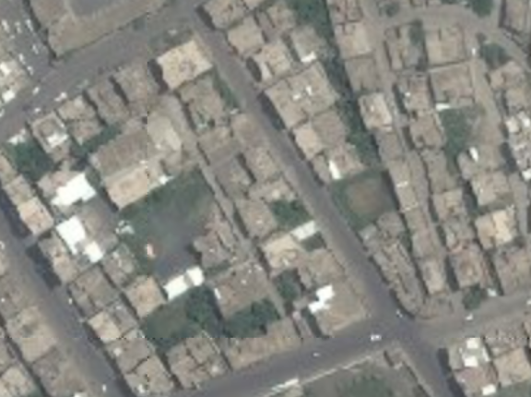

TARGET: JOHN DOE
UNCLASSIFIED (EXAMPLE)
4-I ID
NUMBER: UN4522 AREA: FRAFLEVILLE STREET: HOUSE:
Targeted by: 4-1 ID Area of Operations: TF 2-2 Trigger: HUMINT
DOI: 06 APR 2014
TASK: DETAIN
GRID: 38P MA 11053 44770
PHYSICAL DESCRIPTION
Last given bed down grid for John Doe is from 12 MAR 2014 IIR 13-DC-12-34-56-78
Sex: Male
Age: 41
Height: 5’11”
Body Comp: Normal
Eyes: Brown
Hair: Brown
Other details: Limp in right leg, western style clothing
2
TARGET INFORMATION
Target Category: Criminal mastermind
Impact: Disrupt international crime syndicate
Possible aliases: Slick
Vehicle: Unknown
Family: Unknown
Religion: Unknown
STATUS:
PID:
✓
TARGET SUMMARY: John Doe is an international crime mastermind. He traffics narcotics and weapons and has been known to work with terror groups.
Source:
✓
Location:
X
Intnl Cost:
✓
Source: HUMINT
Evidence:
✓
Trigger:
?
UNCLASSIFIED (EXAMPLE)
Last update with: HUMINT

